Slide 1
Comprehensive Digital Marketing
Project Work on BATA

Slide 2
TEAM MEMBERS
G. Krishna Sri [TEAM LEADER]
K. Sai Lalitha
K. Sushma
G. Vasanthi
K. Sudheer

Slide 3
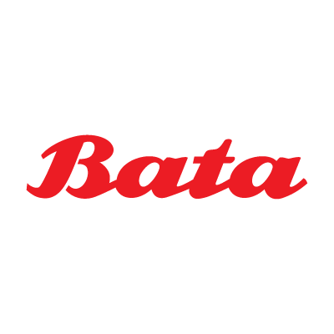
Part 1: Brand study, Competitor Analysis & Buyer’s/Audience’s Persona
Brand : BATA
Website: https://www.bata.com/
Brand Colors: Red, White, Black(occasionally for Bata premium)
Brand Logo:
Mission/Values:
Bata's mission is to be the leading and most admired footwear brand, providing
customers with stylish, comfortable, and high-quality footwear at affordable prices..
Quality, Innovation and Sustainability are its key values.
USP: Bata has positioned itself as a brand that offers good-quality footwear at reasonable
and budget-friendly prices. By providing affordable footwear without compromising on
quality, Bata has established itself as a reliable and popular choice for customers seeking
value for their money.
Tagline: "Bata. Comfortable Shoes for All."

Slide 4
Part 1: Brand study, Competitor Analysis & Buyer’s/Audience’s Persona
Analyse Brand Messaging:
Bata's brand messaging has always been to provide affordable, accessible footwear and is known for emphasizing its heritage and tradition by building trust and reliability among customers through the delivery of quality goods. However, with the recent upgrades and launches, it portrays a message of sustainable fashion, where the comfort and durability of the product remain unchanged.
Examine the brand's tagline:
For a significant period, Bata's brand messaging revolved around key taglines like "I love my shoes" and "Bata comfortable shoes for all," both of which resonated with customers and became widely recognized. Over time, Bata strategically introduced multiple slogans, such as "India's favorite Footwear Brand," "Shoes for all," and "Caring for your feet," showcasing the brand's unwavering commitment to providing footwear that caters to diverse needs and prioritizes customers' well-being. Each new collection launch exemplifies Bata's dedication to remaining fresh and dynamic in the market.

Slide 5
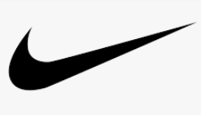
Part 1: Brand study, Competitor Analysis & Buyer’s/Audience’s Persona
Competitor 1: NIKE
Nike is a multinational corporation and one of the world's leading sportswear and athletic footwear brands. Founded in 1964 by Bill Bowerman and Phil Knight, the company started as Blue Ribbon Sports and later changed its name to Nike, inspired by the Greek goddess of victory.
Website: https://www.nike.com/in/
Usp: Includes a powerful brand image, constant innovation and technology integration, strategic endorsements and marketing.
Communication: Influential Athlete Endorsements, inspirational Advertising, Support for Social Causes, Brand Events and Collaborations

Slide 6

Competitor 2 : ADIDAS
Adidas is a multinational sportswear brand with a rich history and a strong presence in the global athletic footwear and apparel market. The company was founded in 1949 by Adolf "Adi" Dassler in Herzogenaurach, Germany. Adi Dassler, along with his brother Rudolf Dassler, was previously involved in a shoe company that eventually split into Adidas and Puma.
Website: https://www.adidas.co.in/
Usp: Adidas' USP is its fusion of performance and style, offering high-quality athletic footwear and apparel with a strong focus on fashion and lifestyle.
Communication: Engaging Social Media Presence, Captivating Storytelling, Sports and Lifestyle Fusion.

Slide 7

Competitor 3:
PUMA is a renowned multinational sports brand that specializes in athletic footwear, apparel, and accessories. The company was founded in 1948 by Rudolf Dassler, the brother of Adi Dassler, who founded Adidas. PUMA has its headquarters in Herzogenaurach, Germany, making it a direct competitor to both Adidas and Bata in the footwear market.
Website: https://www.puma.com/
Usp: PUMA's USP lies in its combination of innovative performance technologies and trendy designs, appealing to athletes and fashion-conscious consumers alike.
Communication: PUMA maintains an engaging social media presence, utilizing captivating storytelling techniques to connect with its target audience. The brand often collaborates with celebrities, athletes, and fashion influencers, enhancing its visibility in the sports and lifestyle sectors.

Slide 8
Part 1: Brand study, Competitor Analysis & Buyer’s/Audience’s Persona
Buyer's/Audience's Persona:
Demographics:
Age: Bata caters to a wide age range, including children, teenagers, adults, and seniors.
Gender: The brand offers footwear options for both males and females.
Income Level: Bata targets consumers from diverse income levels, providing affordable options while also offering premium products.
Psychographics:
Fashion-Forward: Bata appeals to individuals who seek trendy and stylish footwear that complements their fashion sense.
Value-Conscious: The brand targets budget-conscious consumers who prioritize getting good value for their money.
Quality-Seekers: Bata attracts customers who prioritize quality and durability in their footwear choices.
Comfort-Seekers: The brand appeals to individuals who prioritize comfort and support in their everyday shoes.

Slide 9
Behaviors:
Repeat Customers: Bata has a loyal customer base, as many consumers return to the brand for their footwear needs over the years.
Occasional Shoppers: The brand also attracts occasional shoppers who purchase footwear for specific events or occasions.
Online Shoppers: Bata targets consumers who prefer the convenience of online shopping, in addition to its physical store customers.
Brand Awareness: Bata appeals to customers who are familiar with the brand's long-standing presence and reputation.
Interests:
Casual Lifestyle: The brand attracts customers with a casual lifestyle, offering comfortable and stylish footwear for everyday wear.
Fashion Enthusiasts: Bata appeals to those interested in staying updated with the latest footwear trends and designs.
Overall, Bata's target audience encompasses a broad range of demographics, including individuals of different ages, genders, and income levels. The brand focuses on meeting the diverse preferences and needs of its customers, from fashion-conscious individuals to budget-oriented shoppers who prioritize comfort and quality. Bata's longstanding presence, wide product range, and affordability make it an appealing choice for a variety of consumer segments.

Slide 10
Part 2: SEO & Keyword Research
SEO Audit: Do an SEO audit of the brands website
Keyword Research: Define Research Objectives, Brainstorm Seed Keywords, Utilize Keyword Research Tools (SEMrush or Moz Keyword Explorer),Analyze Competitor Keywords, Long-tail Keyword Exploration (specific, longer phrases) that align with the research objectives and have lower competition but higher conversion potential.
On page Optimization: Meta Tag optimization & content optimization
Reflect on the process of conducting keyword research and the SEO recommendations provided.
Document the challenges faced during the research and analysis phase, as well as the key insights gained from the keyword research process.
http://www.bata.com

Slide 11
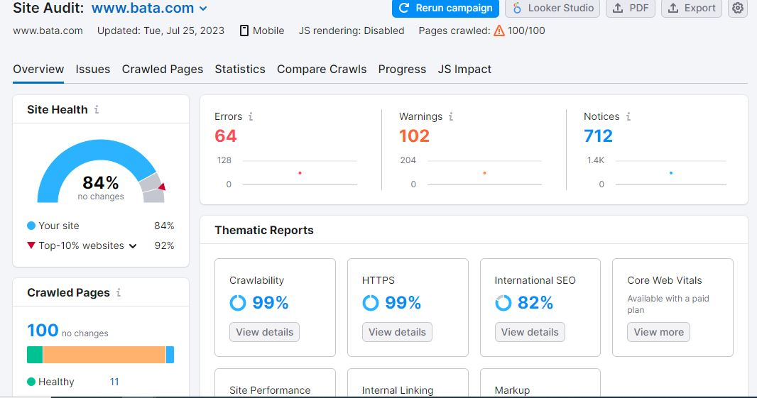
SEO Audit: website: Semrush.com

Slide 12
SEO Audit Summary: The site audit for www.bata.com, indicates that the site's health is rated at 84%, which has remained unchanged since the last evaluation. The crawlability and HTTPS implementation of the website are at a commendable 99%, ensuring smooth accessibility and security. The site performance and internal linking also score high at 100% and 96%, respectively. The markup is well-implemented, with a score of 98%. However, the audit reveals some issues that need attention. There are 64 errors and 102 warnings detected, including incorrect hreflang links(an HTML attribute used to specify the language and geographical targeting of a webpage). hreflang conflicts within page source code, missing title tags, duplicate meta descriptions, and low text to HTML ratio, which has 83 issues. These issues should be addressed to optimize the site's SEO performance and user experience. It's important to note that the Core Web Vitals data is only available with a paid plan, so specific details about this aspect are not provided in the free audit. Overall, while the website performs well in certain areas, resolving the identified issues will be essential to improve its health and enhance the user's experience on www.bata.com.

Slide 13
Keyword Research: website: Semrush.com ubersuggest.com
Objective of Keyword Research for Bata Brand:
Improve organic search visibility
Increase organic traffic
Understand user intent
Conduct competitor analysis
Plan and create relevant content
Target local SEO
Brainstorm Seed Keywords:
Seed keywords are the foundation of your keyword research. These are general, broad terms that are related to the business or industry. Here are some seed keywords for Bata:
Shoes
Stylish Footwear
Shoe trends
Comfortable shoes
Buy shoes Online

Slide 14
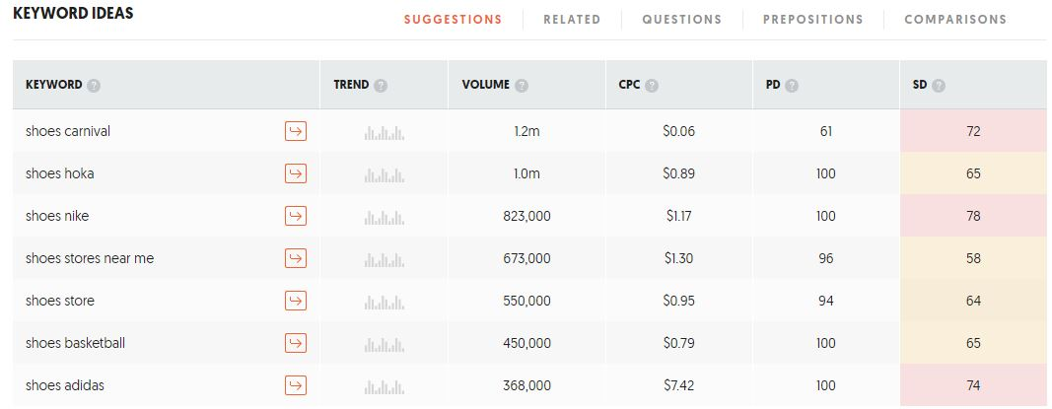
Key Insights:
Shoes Carnival has the highest search volume (1.2 million) and relatively low CPC and PD values, making it potentially attractive for advertising.
Shoes Adidas has a high CPC indicating high competition and cost for PPC campaigns.
Shoes Stores Near Me has a significant search volume and a relatively high CPC, making it potentially valuable for local businesses targeting customers.
Shoes Nike and Shoes Basketball have high PD values indicating high competition in paid advertising.
When selecting keywords, we should consider a balance between search volume, competition level (both paid and organic), and relevance to the business or content.
The data consists of search volume, CPC (Cost Per Click), PD (Paid Difficulty), and SD (SEO Difficulty) for each keyword.
.

Slide 15
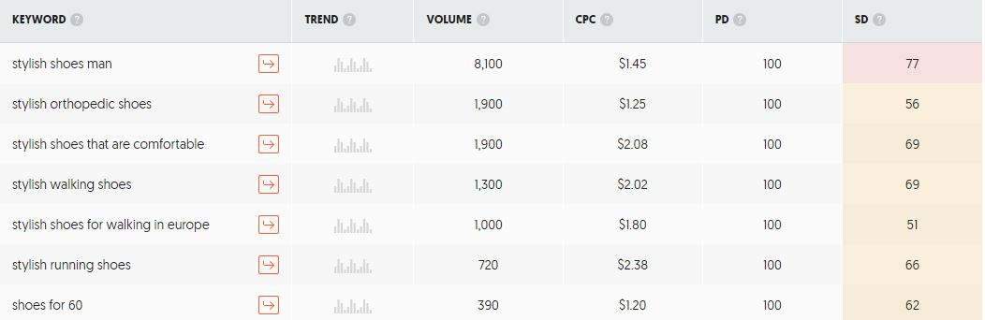
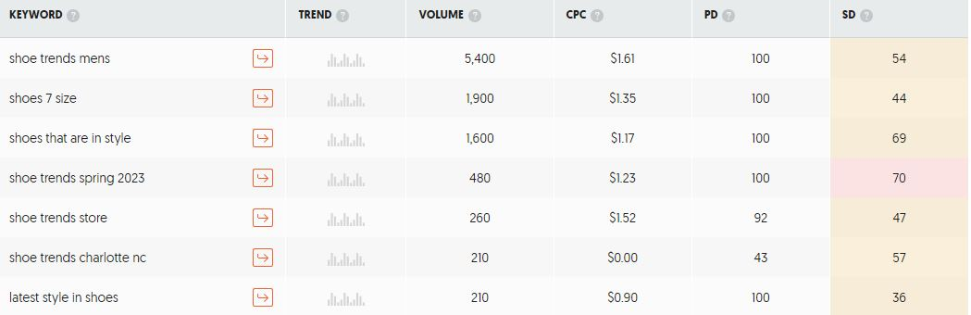
Key Insights:
Stylish Shoes Man: Highly popular keyword with a large search volume and competitive market.
Stylish Orthopedic Shoes: Good search volume, potential niche.
Stylish Shoes for Walking in Europe: Moderately searched and targets travelers or tourists seeking appropriate footwear.
Stylish Running Shoes: Attracts running shoe enthusiasts but faces competitive advertising.
Shoes for 60: Specific audience, lower volume.
Consider prioritizing keywords with high search volume and moderate CPC for advertising.
Long-tail keywords like Stylish Shoes That Are Comfortable may have better conversion rates with targeted audiences

Slide 16
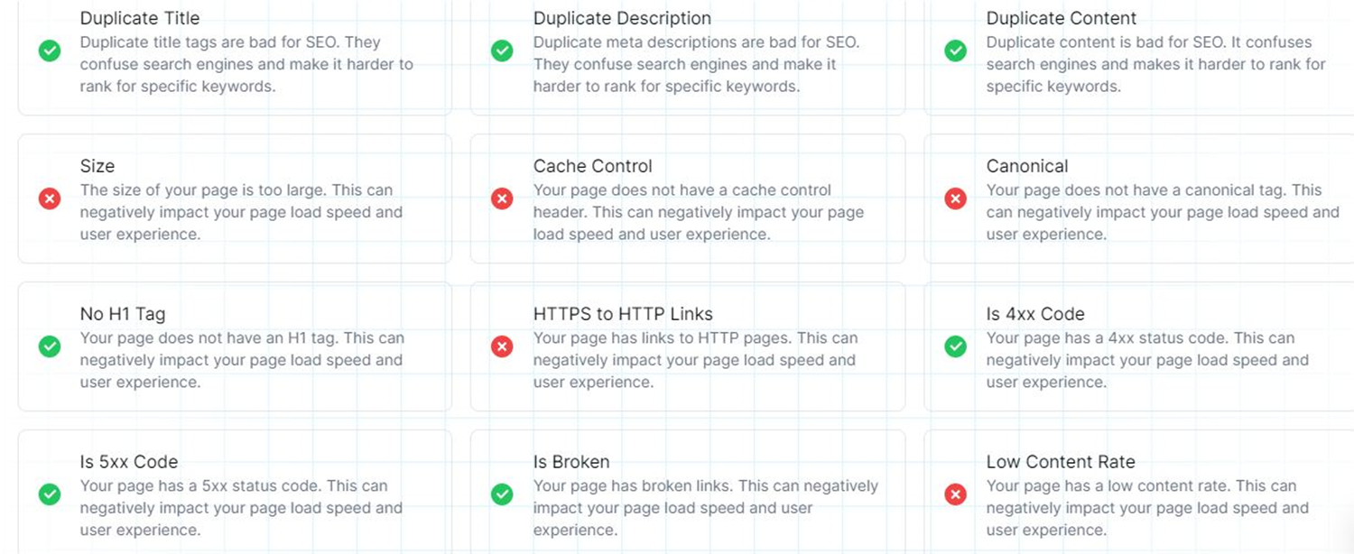
On page Optimization:

Slide 17
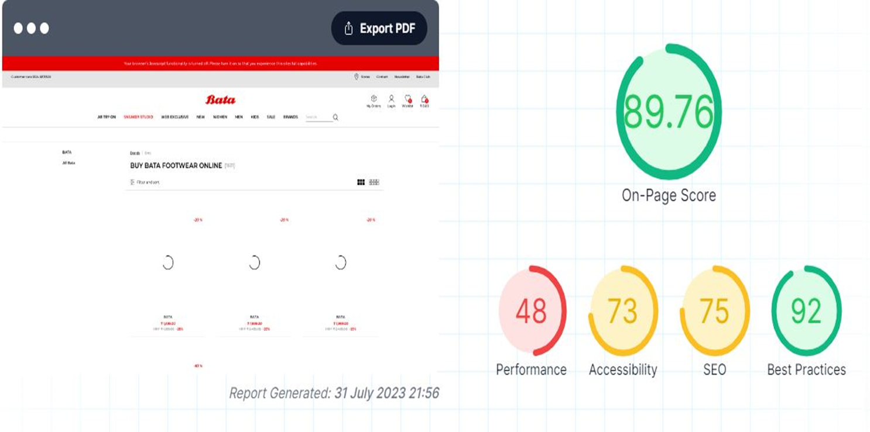
Duplicate Title and Description: Ensure each page has unique title and meta description tags to avoid confusing search engines and improve keyword ranking.
Duplicate Content: Avoid having duplicate content on your website as it can negatively affect SEO and keyword ranking.
Page Size: Reduce the size of your page to improve page load speed and enhance user experience.
Cache Control: Implement a cache control header to optimize page load speed and user experience by enabling browser caching.
Canonical Tag: Include a canonical tag to specify the preferred version of a page and prevent duplicate content issues.
Broken Links: Identify and fix broken links on your page to provide a better user experience and prevent negative impacts on SEO.
Low Content Rate: Increase the amount of valuable and relevant content on your page to improve SEO and user engagement
Page Optimization Summary:

Slide 18
Part 3: Content Ideas and Marketing Strategies
Content Idea Generation & Strategy:
A content calendar has been created that shows the events and campaigns the company will follow through the entire month of august in which a few were Instagram stories, posts, reels, email campaigns and such.
Objective/Aim:
Consistency
Strategic Content Planning
Time Efficiency
Content Variety
Improved Collaboration

Slide 19
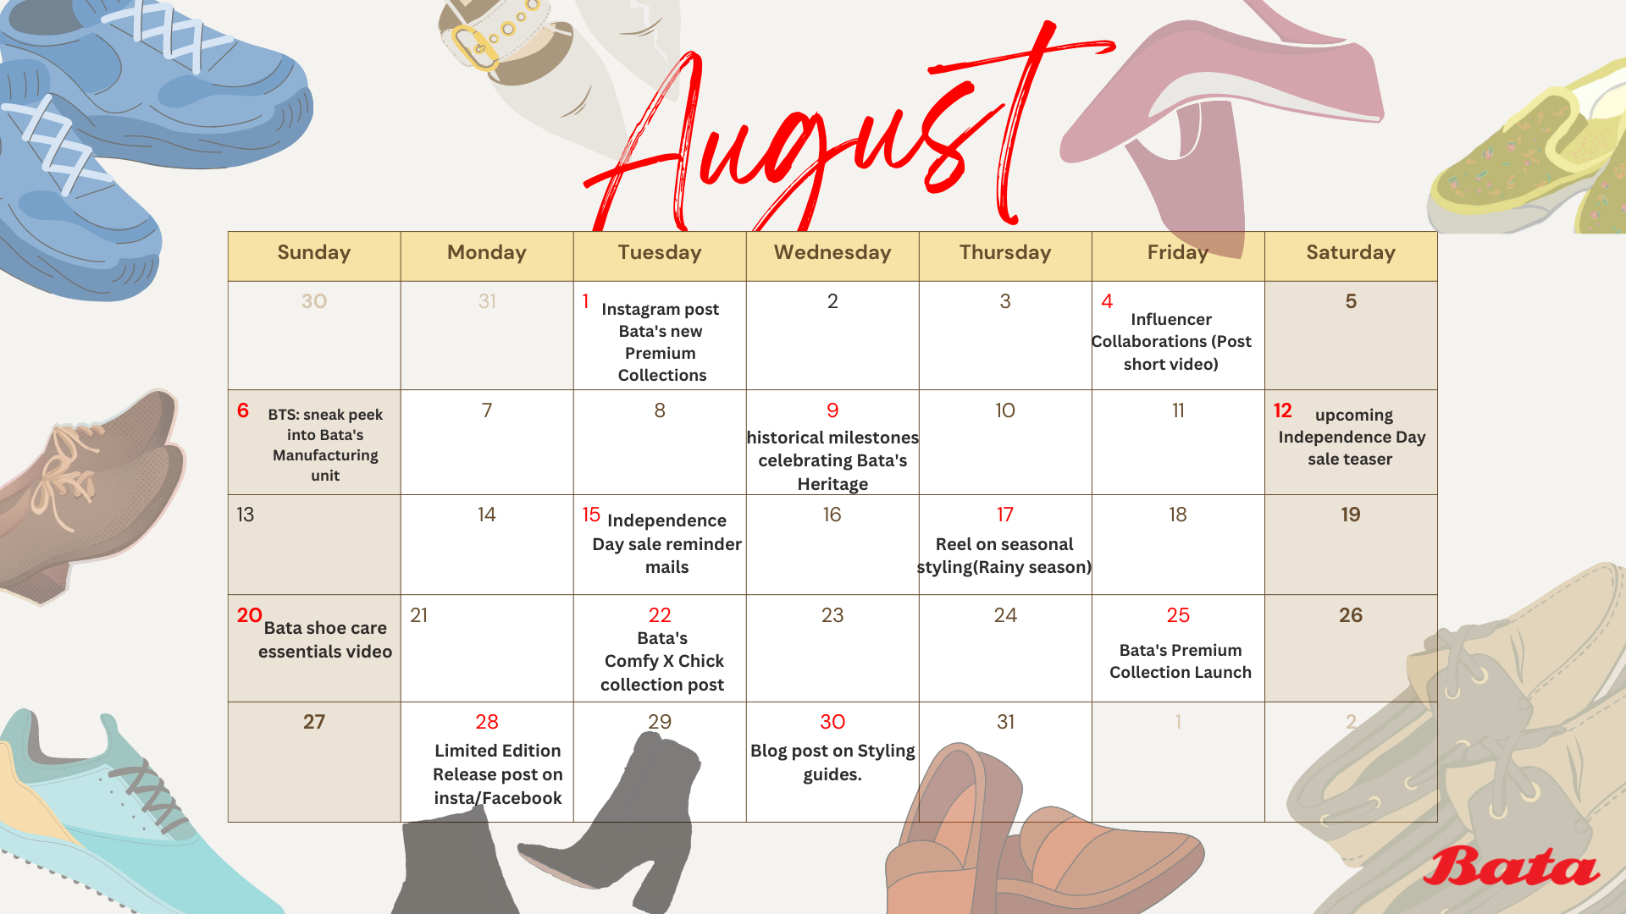

Slide 20
Part 4: Content Creation and Curation (Post creations, Designs/Video Editing, Ad Campaigns over Social Media and Email Ideation and Creation)
Post Creation:
Select Content Categories: Identify three different content formats relevant to the chosen topic or industry. Research and Brainstorm: Research trending topics, industry news, or audience interests within each category. Brainstorm ideas for social media posts that align with each category. Do note that 1 content format has to be video and additionally 3 stories/status are to be created.
Format 1: Instagram Story
Format 2: Designs/Video Editing
Format 3:Social Media Ad Campaigns

Slide 21
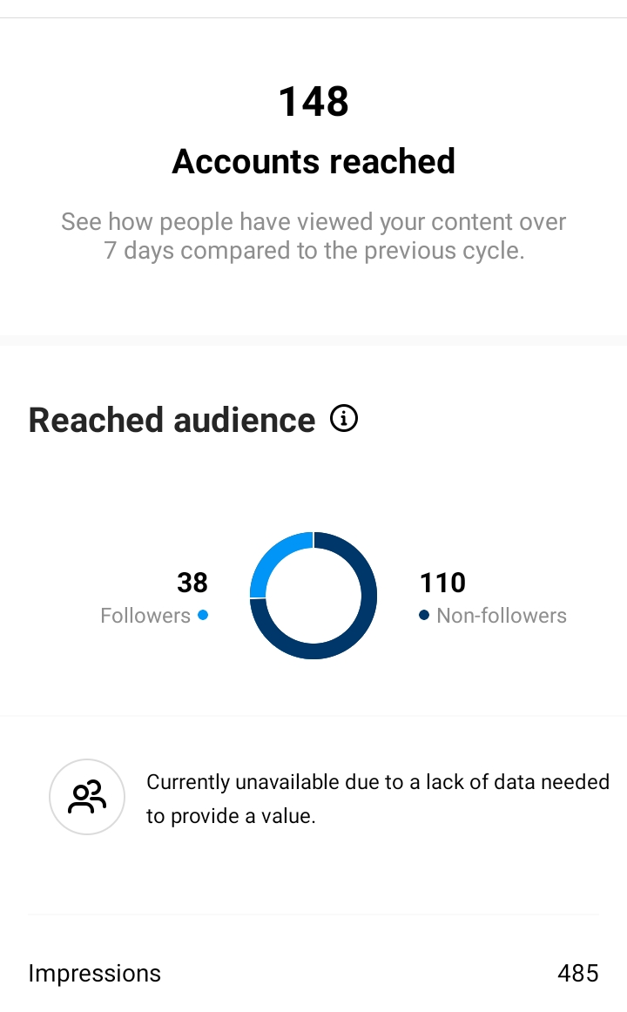
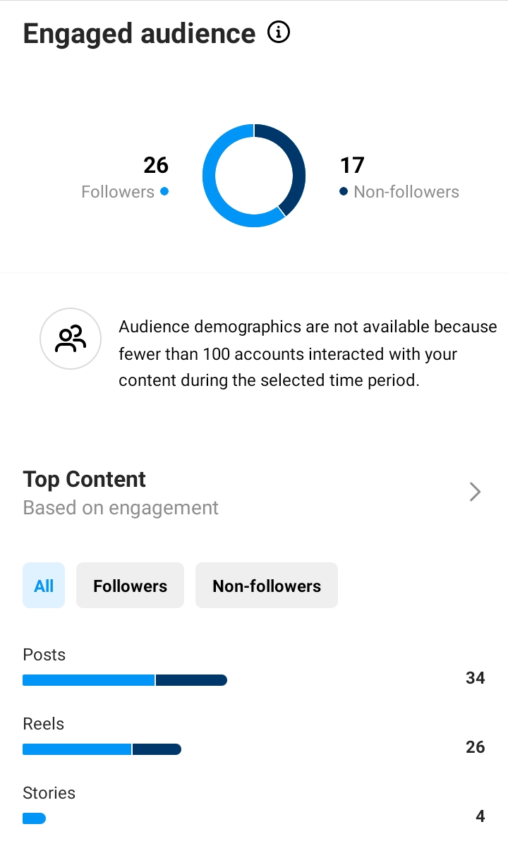
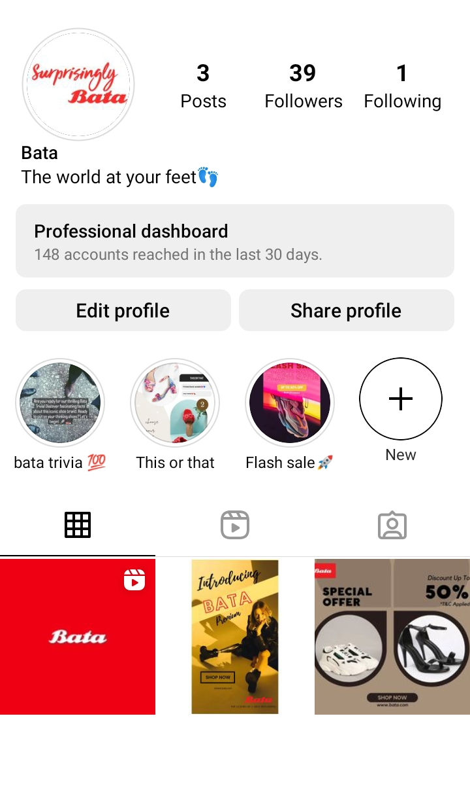
Part 4: Content Creation and Curation (Post creations, Designs/Video Editing, Ad Campaigns over Social Media and Email Ideation and Creation)
Accounts Reached
Accounts engaged
Posts/highlights/insights

Slide 22
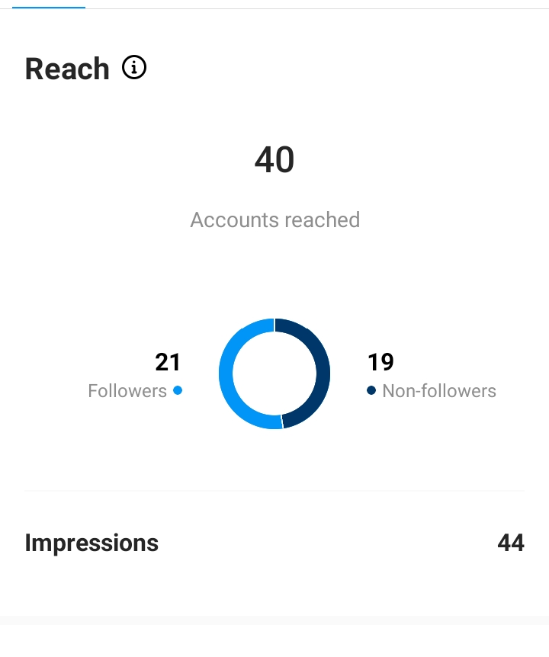
Audience Understanding: Gain insights into your target audience's preferences, interests, and behavior to create content that resonates with them effectively.
Visual Storytelling: Leverage the power of captivating visuals, such as high-quality images and engaging videos, to tell your brand's story and connect with your audience on a deeper level.
Consistency Matters: Maintain a consistent posting schedule and stick to a cohesive content theme to build brand recognition and keep your audience engaged and interested.
Engage and Respond: Actively interact with your followers by responding to comments, messages, and mentions. Building genuine connections with your audience fosters a sense of community and loyalty.
Embrace Instagram Features: Stay up-to-date with the latest features and tools offered by Instagram and experiment with them to stay relevant, leverage trends, and enhance your social media strategy.
Post Creation:
Format 1: Instagram Story
Aim: To increase engagement and keep
customers updated.
Idea: Increase website traffic by posting
relatable and attractive content
Links: click here for the Instagram profile

Slide 23
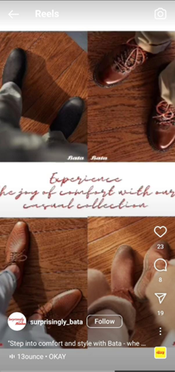
Part 4: Content Creation and Curation (Post creations, Designs/Video Editing, Ad Campaigns over Social Media and Email Ideation and Creation)
Post Creation:
Format 2: Video
Aim: To promote newly launched footwear.
Date: 4th August 2023
Idea: Bata has launched its latest collection of footwear,
and we made a video showing the new styles of footwear.
Topic: The latest styles in footwear.
Links: click here for the video
click here for the Instagram reel
Caption: "Step into comfort and style with Bata - where every step feels like a dream"💫👠 An exciting glimpse into Bata's new foot ware collection👟❤️‍🔥 (This caption was used to introduce Bata’s new collection along with appropriate hashtags).

Slide 24
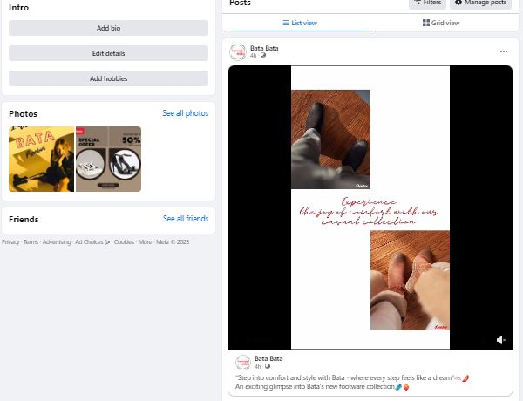
Part 4: Content Creation and Curation (Post creations, Designs/Video Editing, Ad Campaigns over Social Media and Email Ideation and Creation)
Objectives of Facebook campaign:
stablish a Facebook Presence
Engage the Audience
Drive Traffic to Website
Foster Interaction and Trust
Use Facebook Ads Strategically
Analyze Performance and Optimize
View Facebook Page

Slide 25
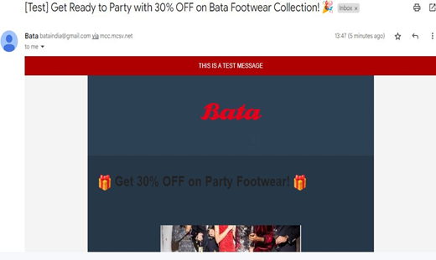
Email Ad Campaigns
Ad Campaigns for email marketing:
Two email campaigns were created using the Mailchimp website – one for lead generation and the other for brand awareness. These campaigns were then sent via Gmail. Each email was crafted with creative ideas, and the most significant challenge was working within the limitations of the free version of Mailchimp. Nevertheless, we maximized the website's capabilities to their full potential, ensuring the success of both campaigns.

Slide 26
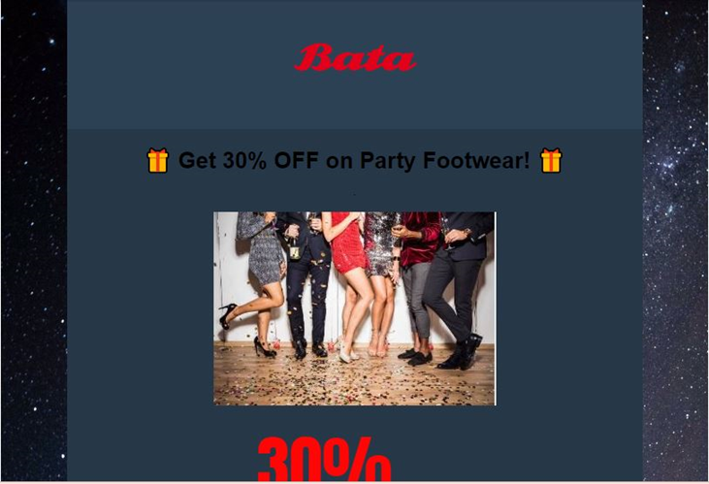
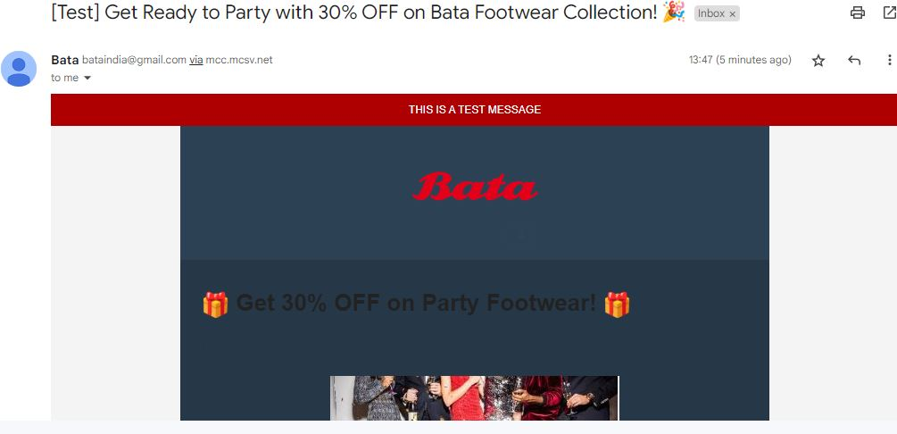
Email Ad Campaign 1 - Brand Awareness
The Mailchimp website is used for creating email campaigns, our email prominently highlights a 30% discount on party collections, making it an attractive offer. Background elements were added for a pop of color, enhancing its visual appeal. Additionally, the logo is clearly displayed, representing the brand effectively. Furthermore, each email's subject is well-defined, helping to convey the purpose of the mail clearly. With its user-friendly interface (such as links of social pages were added) and attention to design.
Website used: Mailchimp
View entire email

Slide 27
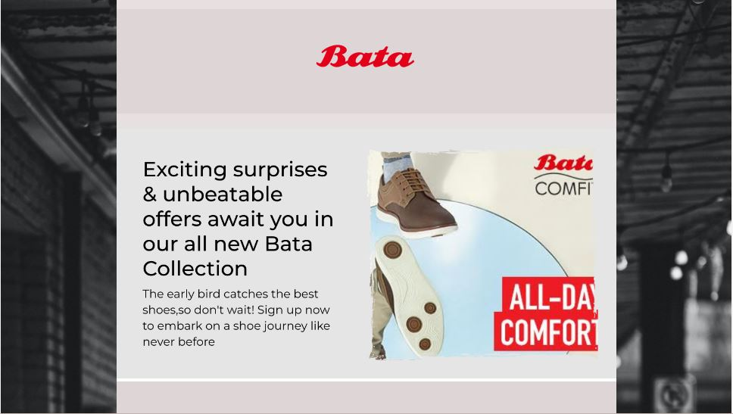
Email Ad Campaign 2 - Lead Generation
The Mailchimp website is used for creating email campaigns, our email prominently encourages to sign upby highlighting comfortable and sustainable fashion of Bata. Background elements were added for a pop of color, enhancing its visual appeal. Additionally, the logo is clearly displayed, representing the brand effectively. Furthermore, each email's subject is well-defined, helping to convey the purpose of the mail clearly. With its user-friendly interface (such as links of social pages were added) and attention to design.
Website used: Mailchimp
View entire email

Slide 28
Part 4: Content Creation and Curation (Post creations, Designs/Video
Editing, Ad Campaigns over Social Media and Email Ideation and Creation)
Lessons Learned:
Effective audience segmentation enhances content and messaging relevance.
Consistent monitoring and data analysis help optimize ad performance.
Continuous optimization is vital to maximize campaign success.
Challenges Faced:
Limited access to full website versions impacted accurate customer journey tracking.
Ad fatigue required regular creative updates to sustain audience interest.
Robust tracking and attribution models were implemented to address tracking limitations.

